Slide 1
Unlocking Property Finance Opportunities for your clients
Commercial | Industrial | Agricultural | Development Finance
23 July 2025 | 09:00 – 10:00

Slide 2
Meet the DB Robertson Financial Services Team
Dennis Robertson – Finance Specialist
Johan Bruwer – Finance Specialist
Gert Oosthuizen – Finance Specialist

Slide 3
Why Partner With Us?
Independent, experienced finance specialists
Access to different banks for finance
Support for your clients = enhanced business for you
Alternative referral income for partners

Slide 4
Our Finance Offering
Commercial:
Offices (Full title & Sectional Title)
Retail centres
Mixed-use buildings
Industrial:
Warehouses
Factories
Logistics spaces
Agricultural:
Farms
Production units
Agribusinesses

Slide 5
Key Criteria
Operating entity / Borrowing entity must have a trading history of at least 2 years (Norm = 3 years)
Operating entity / Borrowing entity must have financial statements
Maximum loan repayment term = 10 years
LTV's range between 50% to 90%

Slide 6
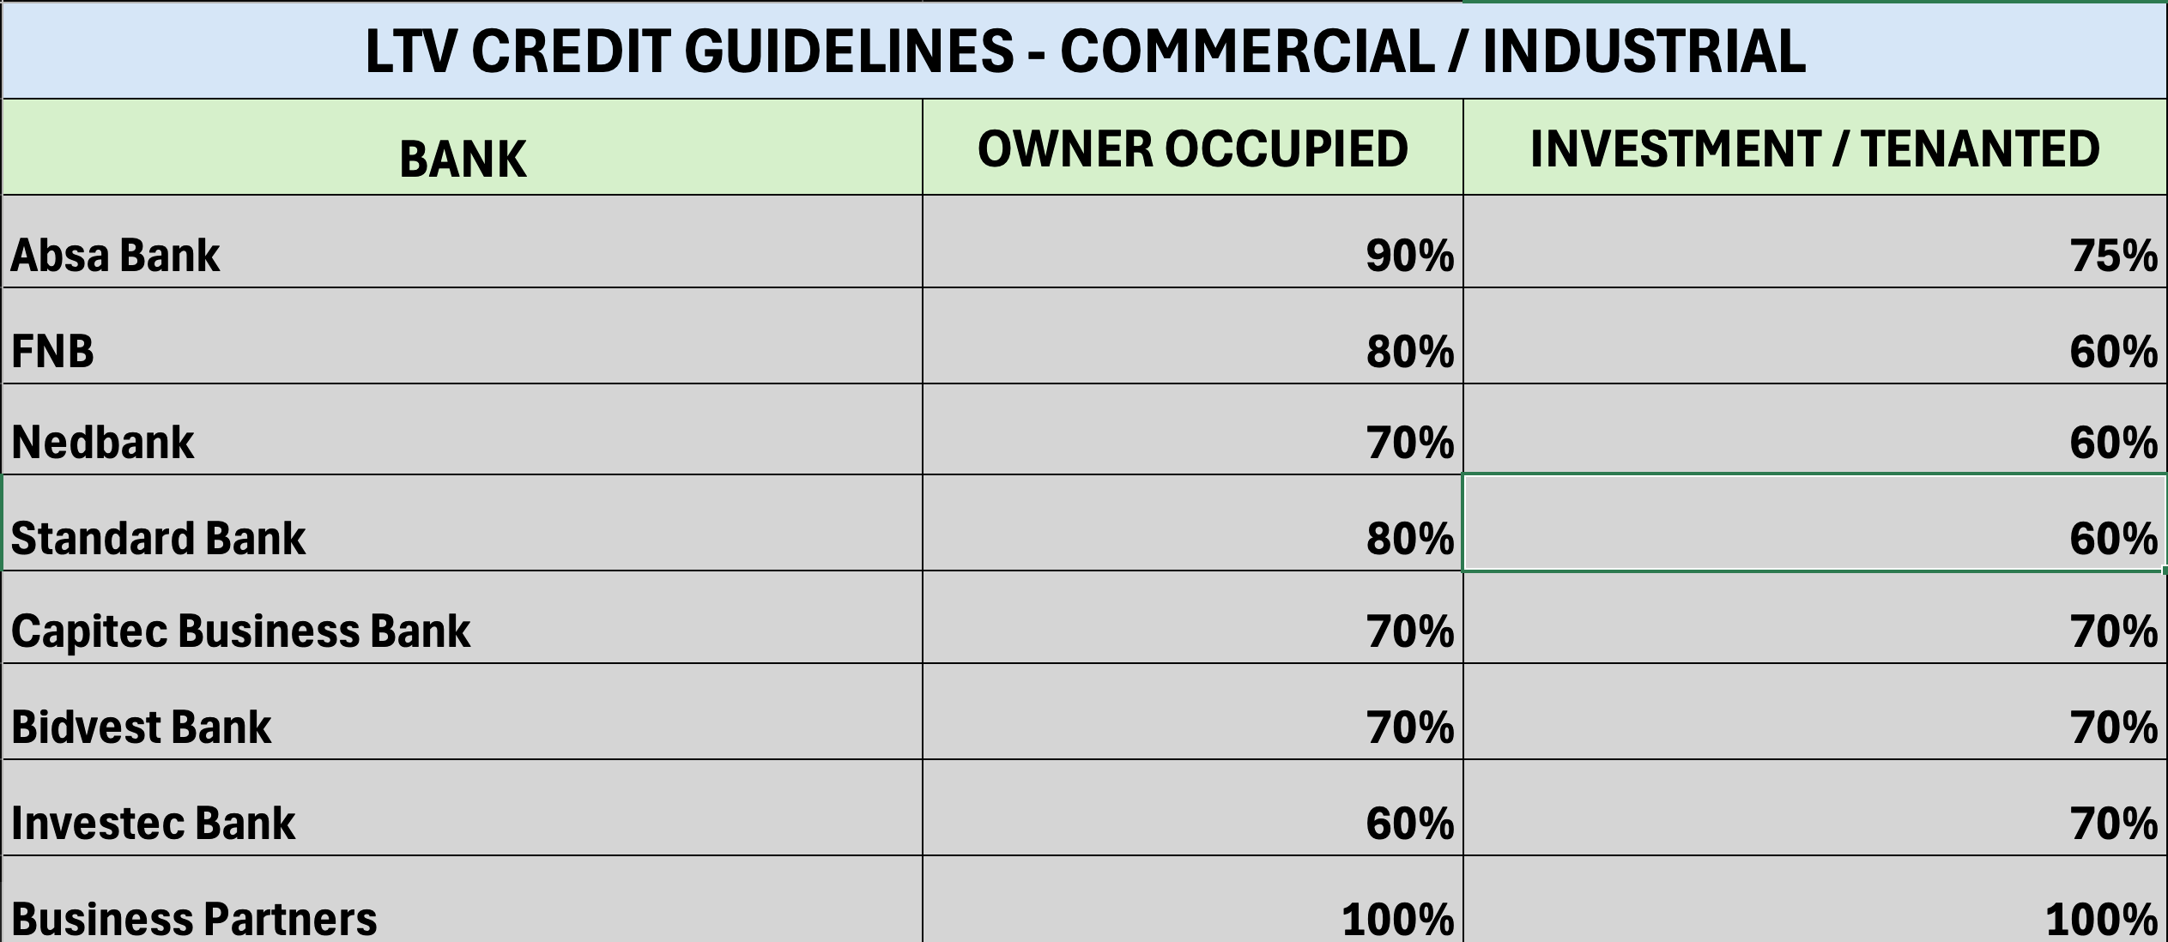

Slide 7
What We Need From You
1.Completed Lead Form
2.Completed and signed Commercial Loan: Third Party Consent Form
Email to: Dennis Robertson - dennis@DBRFin.com
Copy in : Delia Visser - delia.visser@Mortgagemax.co.za

Slide 8

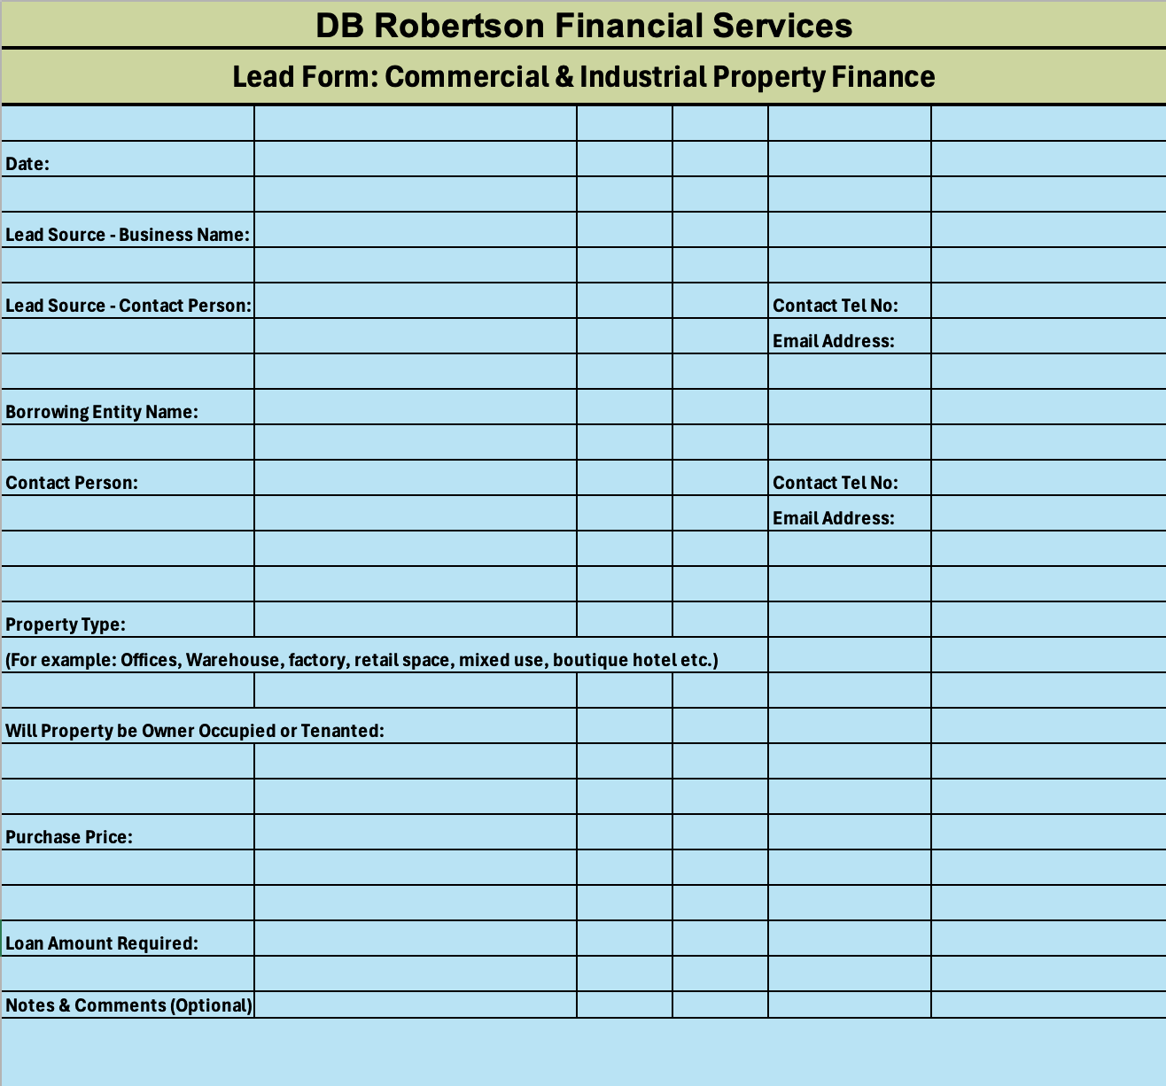

Slide 9

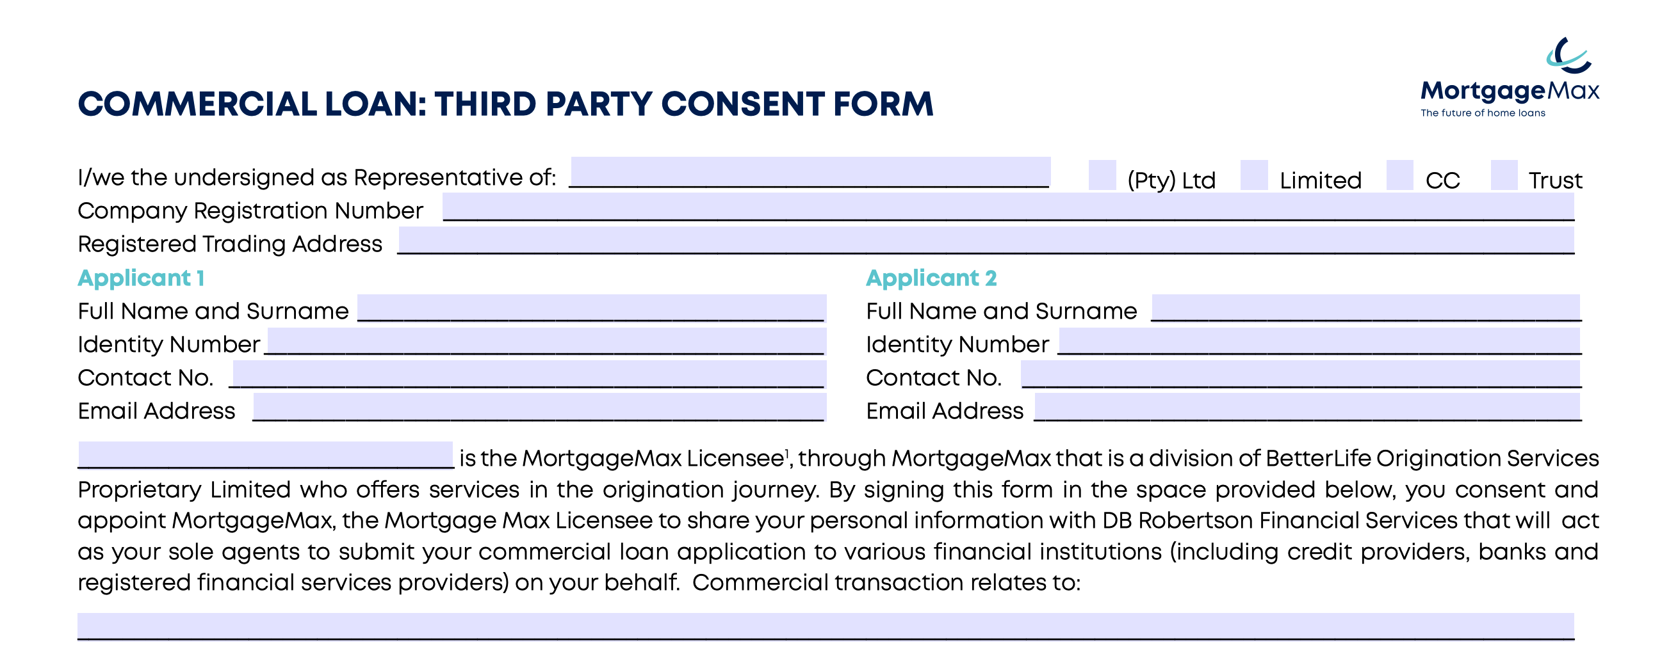

Slide 10
From Lead to Loan
Our Process and Service Levels
1. Receive lead from Business Partner. (Acknowledge receipt within 8 hours.)
2. Make contact with client to schedule a information session, and discuss our fees and arrange signing of our Finance Consulting Agreement. (Within 48 hours)
3. Meet with client to discuss background and finance need. (ASAP)
4. Send email to client with list of required documentation and forms. (Same day.)
5. Receive documentation, assess, write motivation and submit to banks.
6. Upon approval in principle client is informed and valuation is requested.
7. Final approval issued and sent to client for acceptance.
8. Upon acceptance of final approval, client is invoiced for our Consultancy Fee.
9. Upon receipt of payment of fee from client, referral fee is paid to BetterLife Origination Services.

Slide 11
Property type exclusions
Shareblock properties
Gambling venues
Adult entertainment clubs
Rental stock with informal housing / backyard shacks
Unserviced vacant land
Property being purchased in the name of individuals
High Risk areas

Slide 12
Property type low appetite
Vacant Land (Limited to 50% LTV)
Guest Houses / farms
Filling stations
Alternative building methods
Student Accommodation (Only some banks)
Leasehold properties
No standalone property loans (Only some banks)
Game Farms
Any properties that poses a reputational risk (eg churches, schools etc

Slide 13
Our Service Levels
Regular updates to referral partners
Transparent communication throughout the process
High success rate with quality submissions

Slide 14
Live Q&A
We’re here to answer your questions
Please feel free to use the chat or raise your hand

Slide 15
Let’s Connect
Dennis Robertson
Email: dennis@DBRFin.com
Phone: 076 737 0037
Johan Bruwer
Email: johan@DBRFin.com
Phone: 082 781 9926
Gert Oosthuizen
Email: gert@DBRFin.com
Phone: 084 700 5707

